Slide 1
STAT3007: Introduction to Stochastic Processes
First Step Analysis
Dr. John Wright

Slide 2
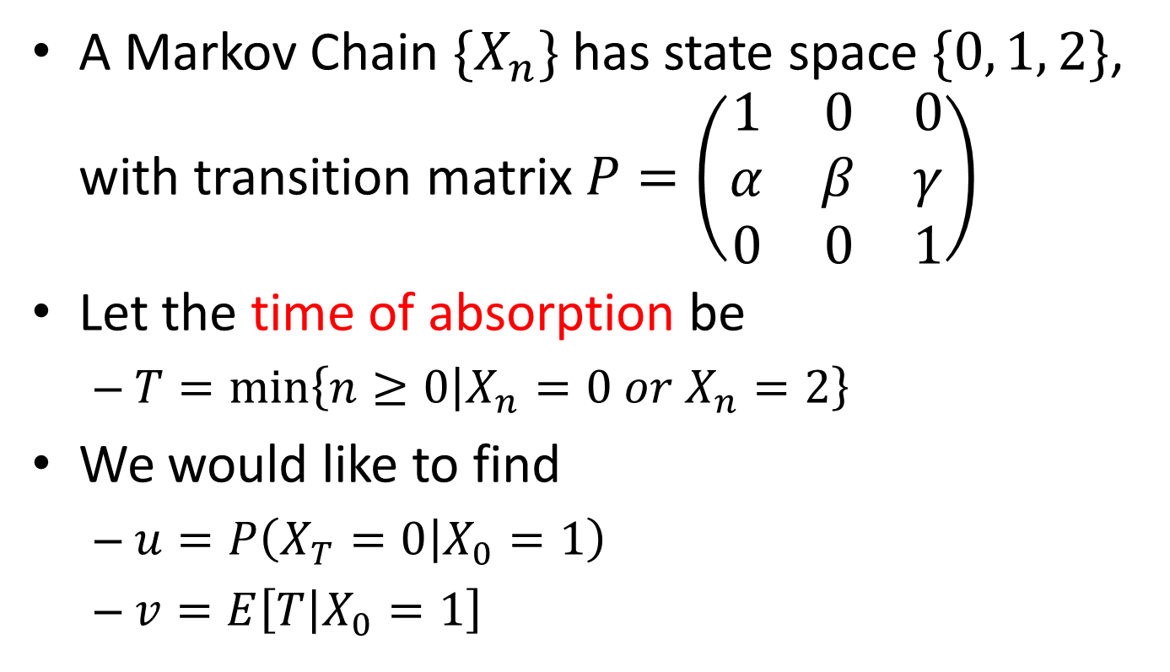
Simple First Step Analysis
A Markov Chain $\{X_{n}\}$ has state space $\{0, 1, 2\}$, with transition matrix $P=\left(\begin{matrix}1 & 0 & 0 \\ α & β & γ \\ 0 & 0 & 1\end{matrix}\right)$
Let the time of absorption be
$T=\min\left\{n≥0 | X_{n}=0 or X_{n}=2\right\}$
We would like to find
$u=P\left(X_{T}=0 | X_{0}=1\right)$
$v=E\left[T | X_{0}=1\right]$

Slide 3
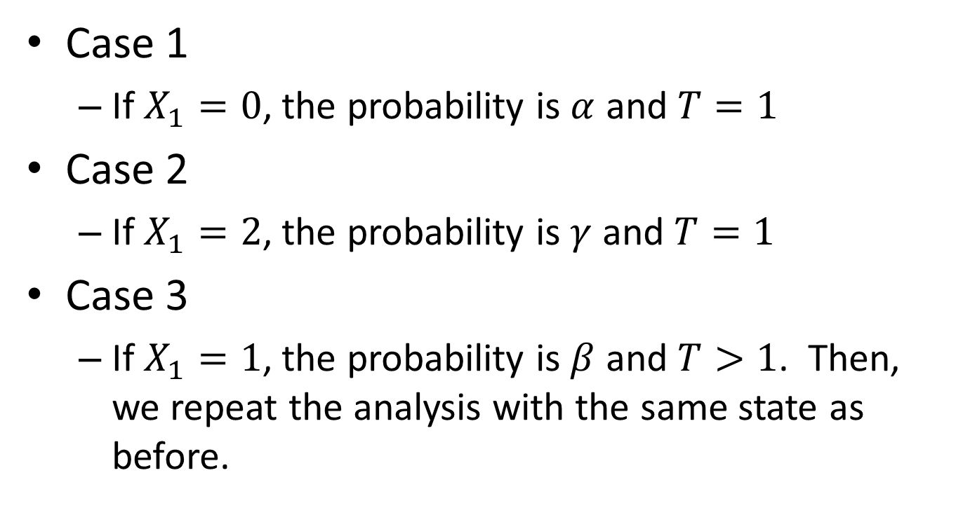
Simple First Step Analysis
Case 1
If $X_{1}=0$, the probability is $α$ and $T=1$
Case 2
If $X_{1}=2$, the probability is $γ$ and $T=1$
Case 3
If $X_{1}=1$, the probability is $β$ and $T>1$. Then, we repeat the analysis with the same state as before.

Slide 4
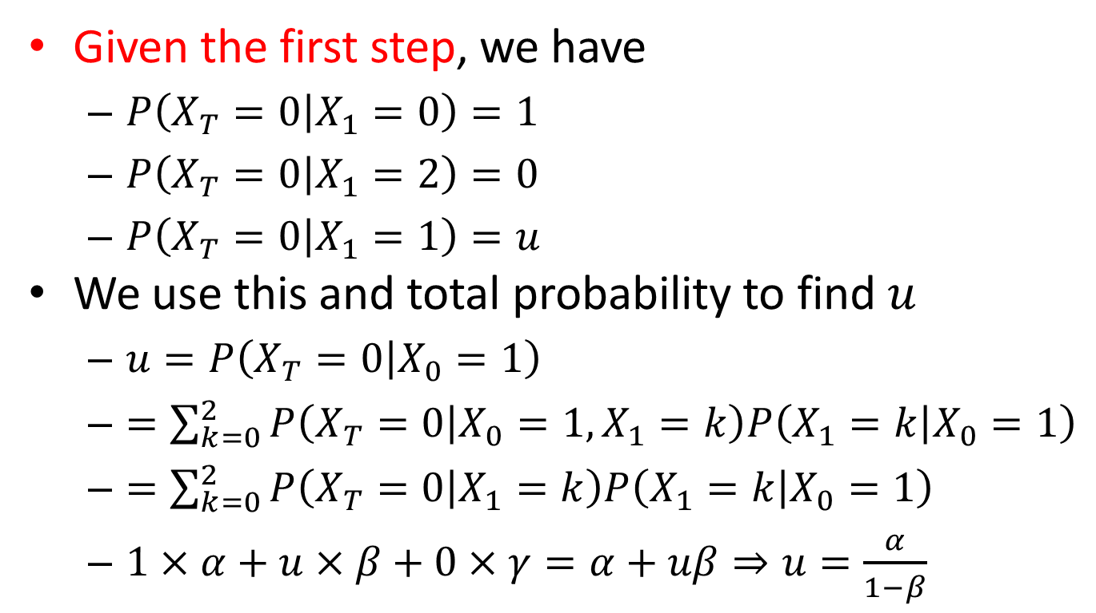
Simple First Step Analysis
Given the first step, we have
$P\left(X_{T}=0 | X_{1}=0\right)=1$
$P\left(X_{T}=0 | X_{1}=2\right)=0$
$P\left(X_{T}=0 | X_{1}=1\right)=u$
We use this and total probability to find $u$
$u=P\left(X_{T}=0 | X_{0}=1\right)$
$=\sum_{k=0}^{2}{P\left(X_{T}=0 | X_{0}=1,X_{1}=k\right)P\left(X_{1}=k | X_{0}=1\right)}$
$=\sum_{k=0}^{2}{P\left(X_{T}=0 | X_{1}=k\right)P\left(X_{1}=k | X_{0}=1\right)}$
$1×α+u×β+0×γ=α+uβ⇒u=\frac{α}{1−β}$

Slide 5
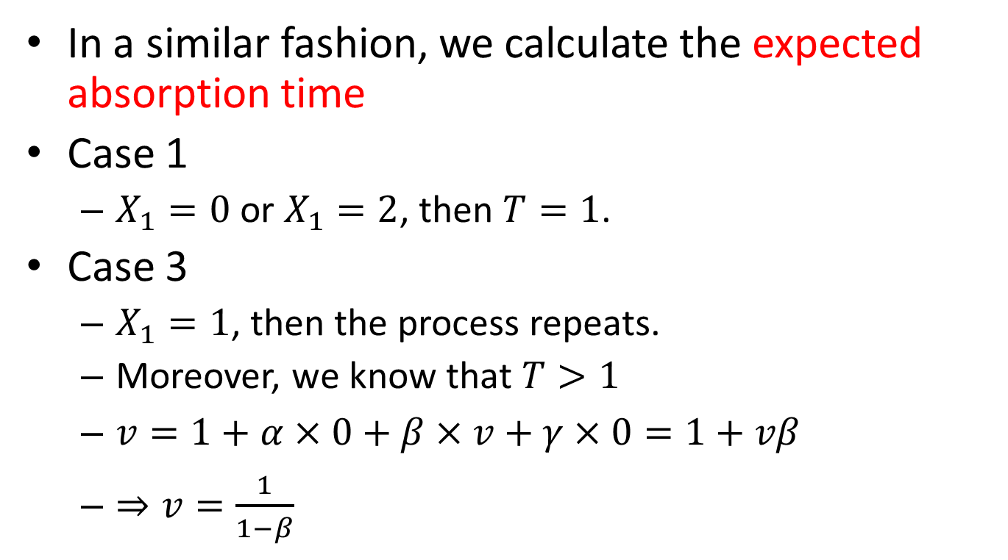
Simple First Step Analysis
In a similar fashion, we calculate the expected absorption time
Case 1
$X_{1}=0$or $X_{1}=2$, then $T=1$.
Case 3
$X_{1}=1$, then the process repeats.
Moreover, we know that $T>1$
$v=1+α×0+β×v+γ×0=1+vβ$
$⇒v=\frac{1}{1−β}$

Slide 6
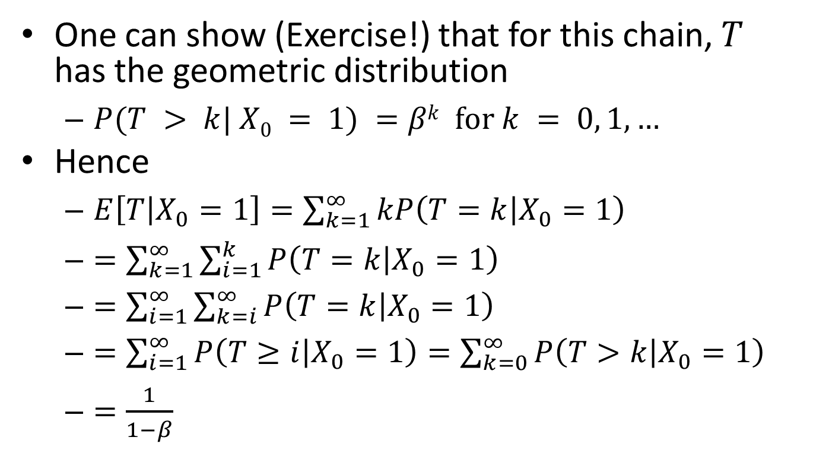
Simple First Step Analysis
One can show (Exercise!) that for this chain, $T$ has the geometric distribution
$P(T > k| X0 = 1) =βk for k = 0, 1, …$
Hence
$E\left[T | X_{0}=1\right]=\sum_{k=1}^{∞}{kP\left(T=k | X_{0}=1\right)}$
$=\sum_{k=1}^{∞}{\sum_{i=1}^{k}{P\left(T=k | X_{0}=1\right)}}$
$=\sum_{i=1}^{∞}{\sum_{k=i}^{∞}{P\left(T=k | X_{0}=1\right)}}$
$=\sum_{i=1}^{∞}{P\left(T≥i | X_{0}=1\right)}=\sum_{k=0}^{∞}{P\left(T>k | X_{0}=1\right) }$
$=\frac{1}{1−β}$

Slide 7
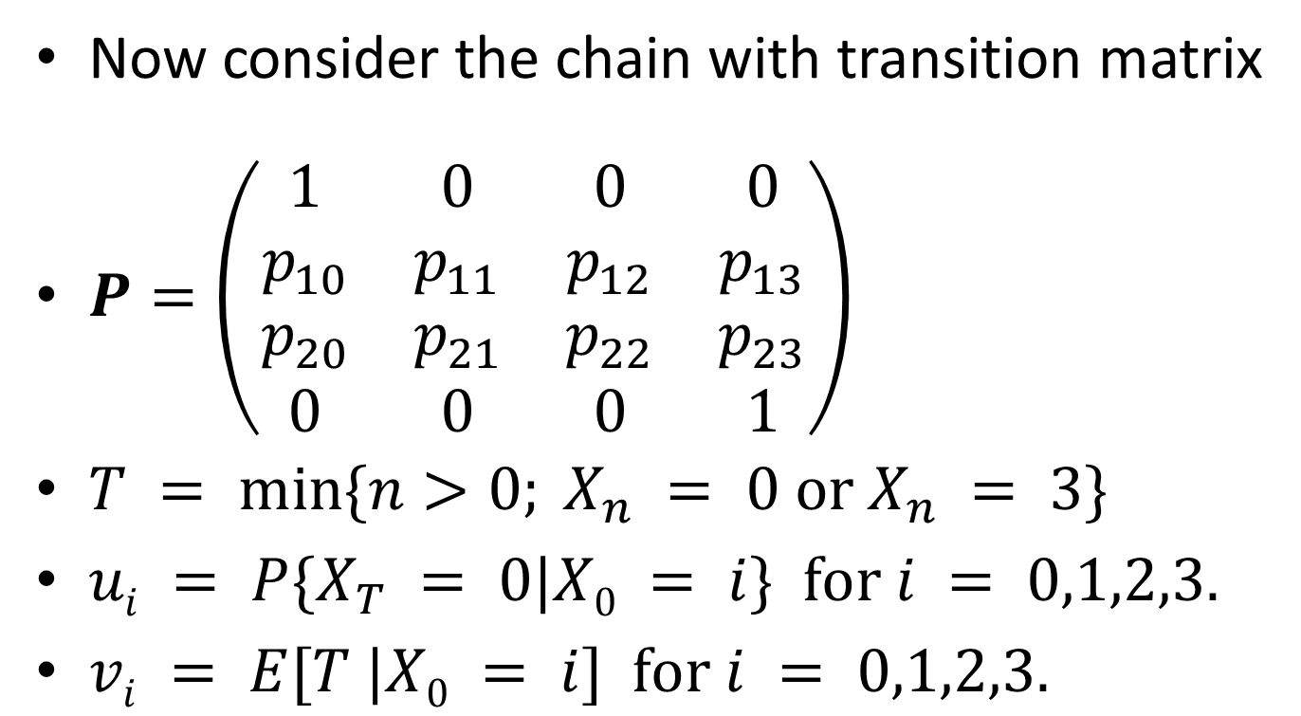
Slightly Harder First Step Analysis
Now consider the chain with transition matrix
$P=\left(\begin{matrix}1 & 0 & 0 & 0 \\ p_{10} & p_{11} & p_{12} & p_{13} \\ p_{20} & p_{21} & p_{22} & p_{23} \\ 0 & 0 & 0 & 1\end{matrix}\right)$
$T = min⁡\{n>0; X_{n} = 0 or X_{n} = 3\}$
$ui = P\{X_{T} = 0|X0 = i\} for i = 0,1,2,3.$
$vi = E[T |X0 = i] for i = 0,1,2,3.$

Slide 8
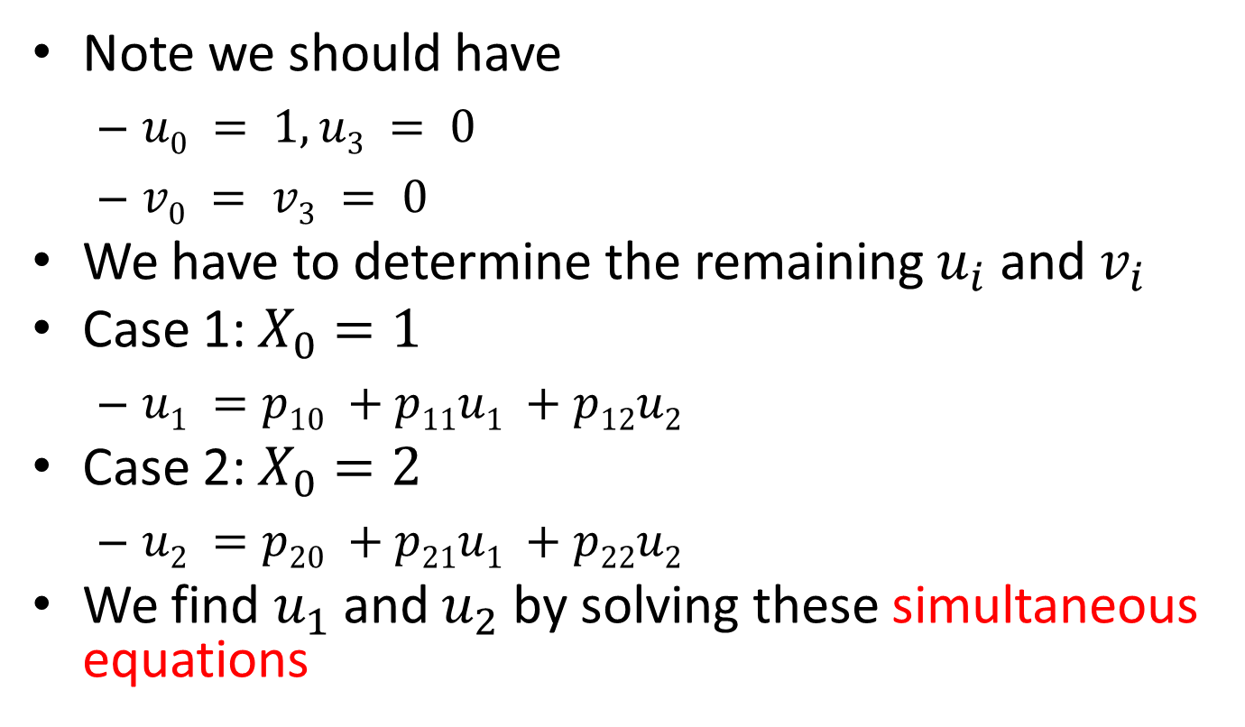
Slightly Harder First Step Analysis
Note we should have
$u0 = 1, u3 = 0$
$v0 = v3 = 0$
We have to determine the remaining $u_{i}$ and $v_{i}$
Case 1: $X_{0}=1$
$u1 =p10 +p11u1 +p12u2$
Case 2: $X_{0}=2$
$u2 =p20 +p21u1 +p22u2$
We find $u_{1}$ and $u_{2}$ by solving these simultaneous equations

Slide 9
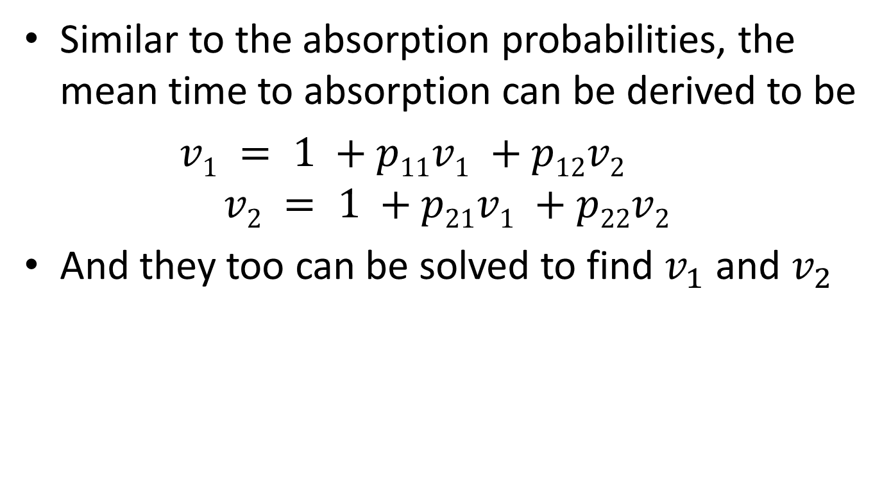
Slightly Harder First Step Analysis
Similar to the absorption probabilities, the mean time to absorption can be derived to be
$v1 = 1 +p11v1 +p12v2$
$$v2 = 1 +p21v1 +p22v2$$
And they too can be solved to find $v_{1}$ and $v_{2}$

Slide 10
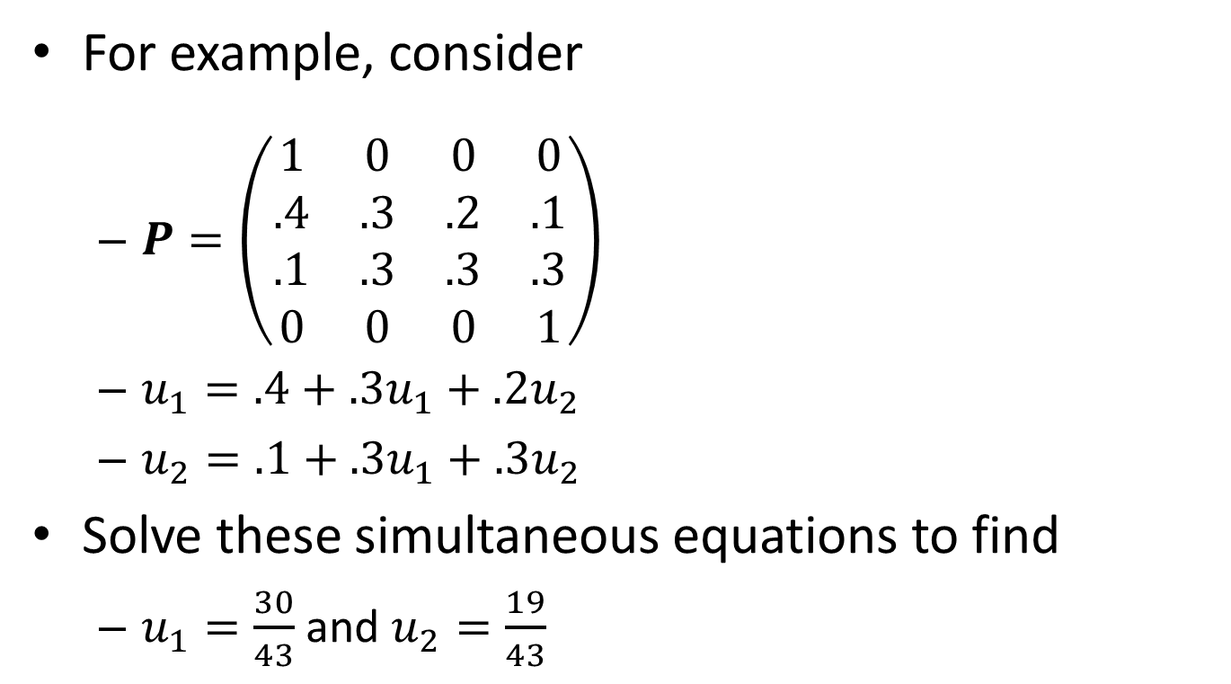
Slightly Harder First Step Analysis
For example, consider
$P=\left(\begin{matrix}1 & 0 & 0 & 0 \\ .4 & .3 & .2 & .1 \\ .1 & .3 & .3 & .3 \\ 0 & 0 & 0 & 1\end{matrix}\right)$
$u_{1}=.4+.3u_{1}+.2u_{2}$
$u_{2}=.1+.3u_{1}+.3u_{2}$
Solve these simultaneous equations to find
$u_{1}=\frac{30}{43}$ and $u_{2}=\frac{19}{43}$

Slide 11
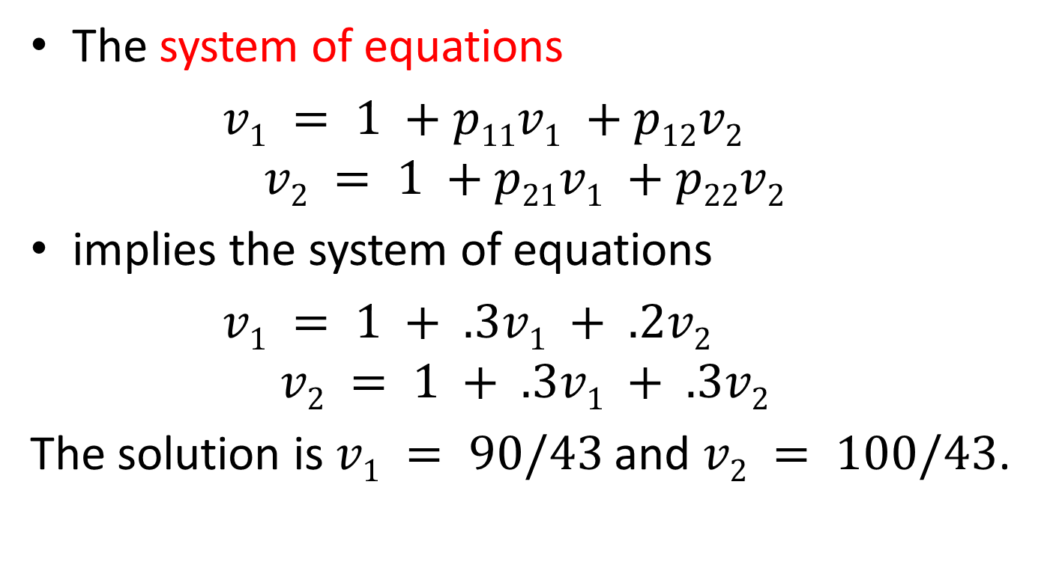
Slightly Harder First Step Analysis
The system of equations
$v1 = 1 +p11v1 +p12v2$
$$v2 = 1 +p21v1 +p22v2$$
implies the system of equations
$v1 = 1 + .3v1 + .2v2$
$$v2 = 1 + .3v1 + .3v2$$
The solution is $v1 = 90/43$and $v2 = 100/43$.

Slide 12
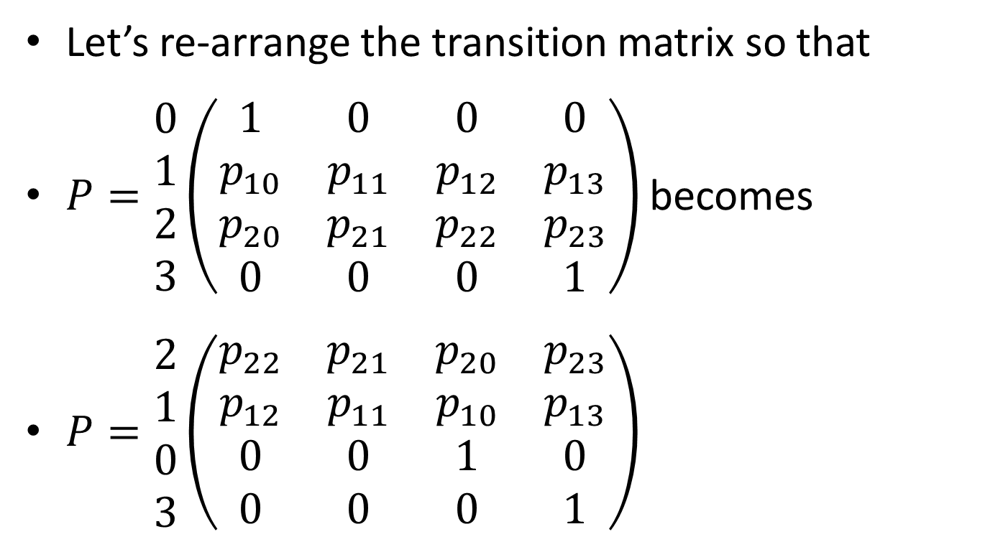
General First Step Analysis
Let’s re-arrange the transition matrix so that
$P=\begin{matrix}0 \\ 1 \\ 2 \\ 3\end{matrix}\left(\begin{matrix}1 & 0 & 0 & 0 \\ p_{10} & p_{11} & p_{12} & p_{13} \\ p_{20} & p_{21} & p_{22} & p_{23} \\ 0 & 0 & 0 & 1\end{matrix}\right)$ becomes
$P=\begin{matrix}2 \\ 1 \\ 0 \\ 3\end{matrix}\left(\begin{matrix}p_{22} & p_{21} & p_{20} & p_{23} \\ p_{12} & p_{11} & p_{10} & p_{13} \\ 0 & 0 & 1 & 0 \\ 0 & 0 & 0 & 1\end{matrix}\right)$

Slide 13
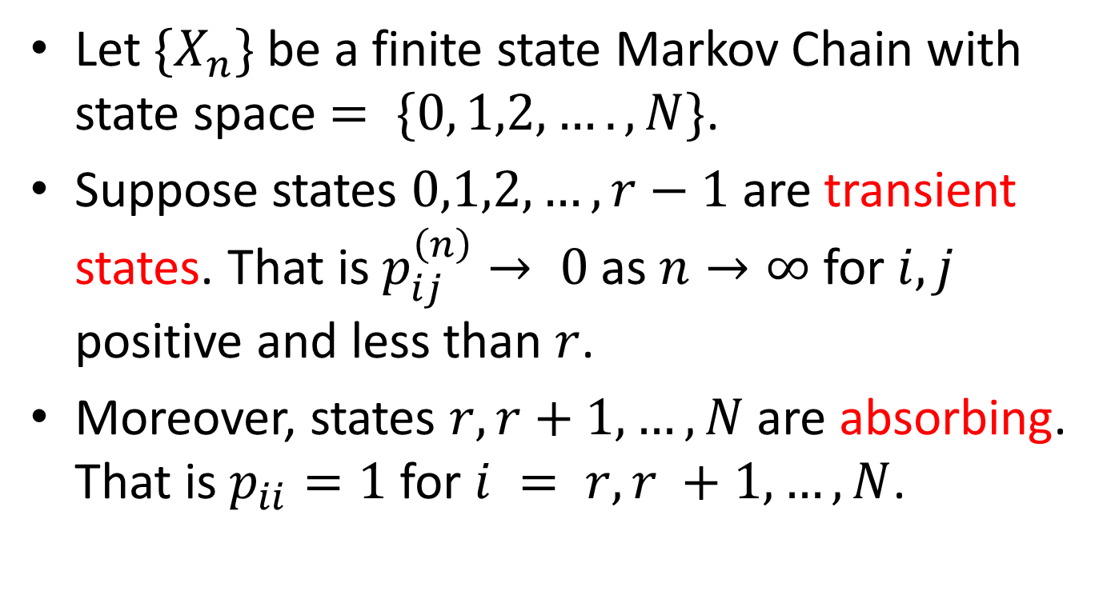
General First Step Analysis
Let $\{X_{n}\}$ be a finite state Markov Chain with state space $= \{0, 1,2, …., N\}$.
Suppose states $0,1,2, …, r−1$are transient states. That is $p_{ij}^{\left(n\right)}→ 0$as $n→∞$ for $i,j$ positive and less than $r$.
Moreover, states $r, r+1, …, N$are absorbing. That is $p_{ii}=1$ for $i = r,r +1, …, N$.

Slide 14
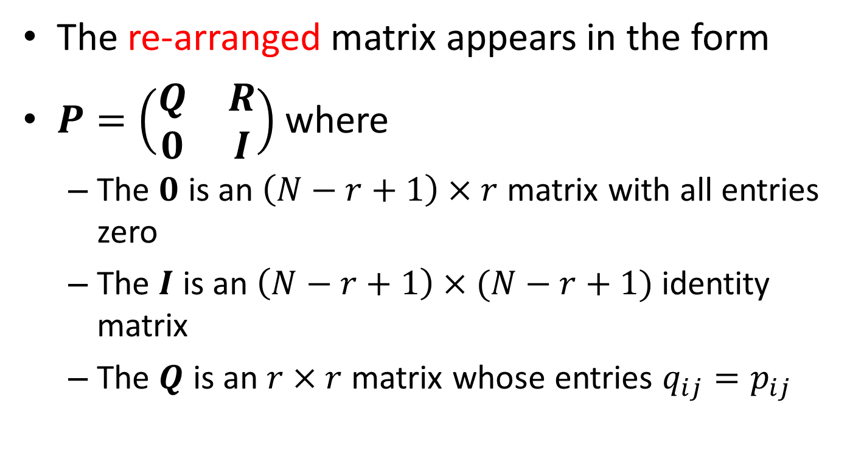
General First Step Analysis
The re-arranged matrix appears in the form
$P=\left(\begin{matrix}Q & R \\ 0 & I\end{matrix}\right)$ where
The $0$ is an $\left(N−r+1\right)×r$ matrix with all entries zero
The $I$ is an $\left(N−r+1\right)×(N−r+1)$ identity matrix
The $Q$ is an $r×r$ matrix whose entries $q_{ij}=p_{ij}$

Slide 15
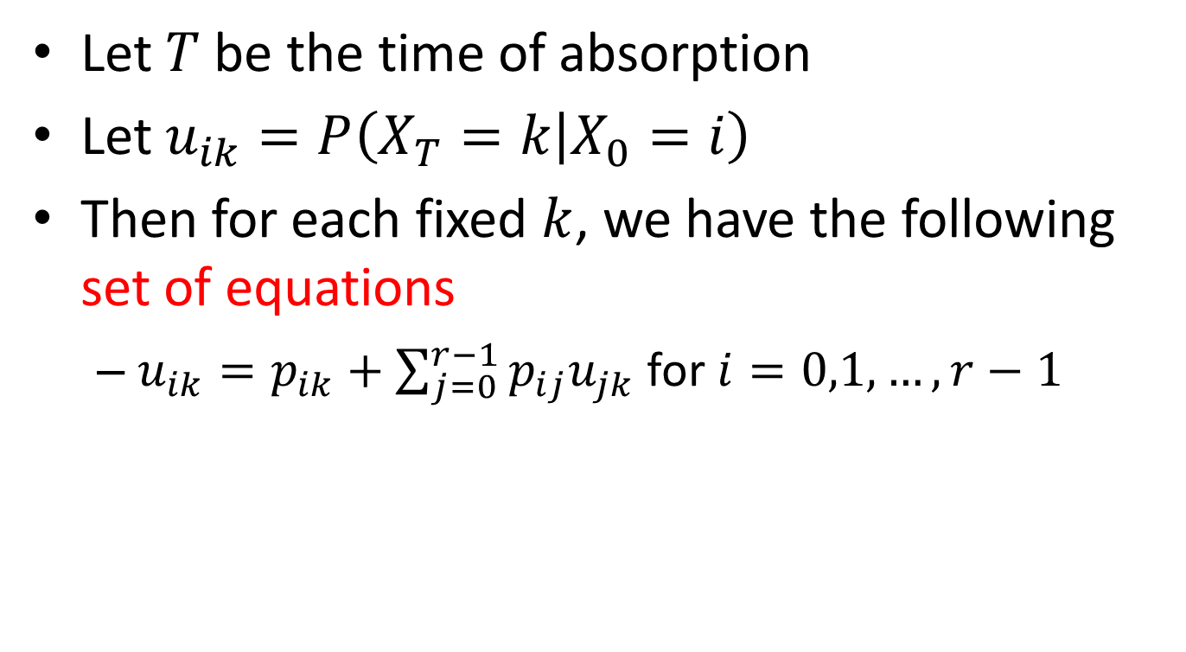
General First Step Analysis
Let $T$ be the time of absorption
Let $u_{ik}=P\left(X_{T}=k | X_{0}=i\right)$
Then for each fixed $k$, we have the following set of equations
$u_{ik}=p_{ik}+\sum_{j=0}^{r−1}{p_{ij}u_{jk}}$ for $i=0,1,…,r−1$

Slide 16
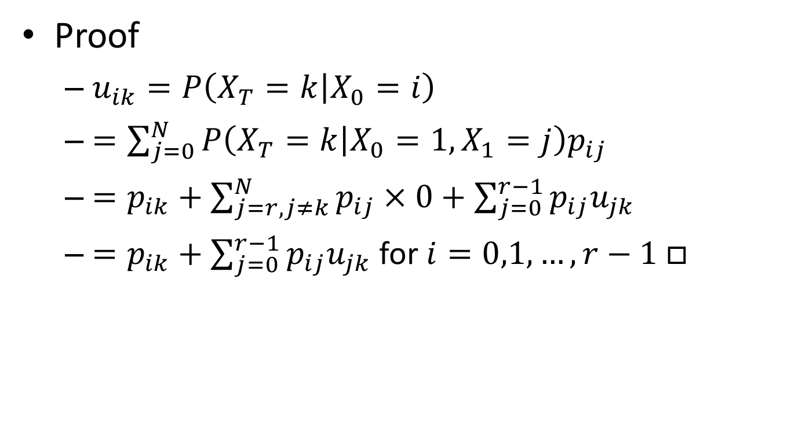
General First Step Analysis
Proof
$u_{ik}=P\left(X_{T}=k | X_{0}=i\right)$
$=\sum_{j=0}^{N}{P\left(X_{T}=k | X_{0}=1,X_{1}=j\right)p_{ij}}$
$=p_{ik}+\sum_{j=r,j≠k}^{N}{p_{ij}×0}+\sum_{j=0}^{r−1}{p_{ij}u_{jk}}$
$=p_{ik}+\sum_{j=0}^{r−1}{p_{ij}u_{jk}}$ for $i=0,1,…,r−1$ $□$

Slide 17
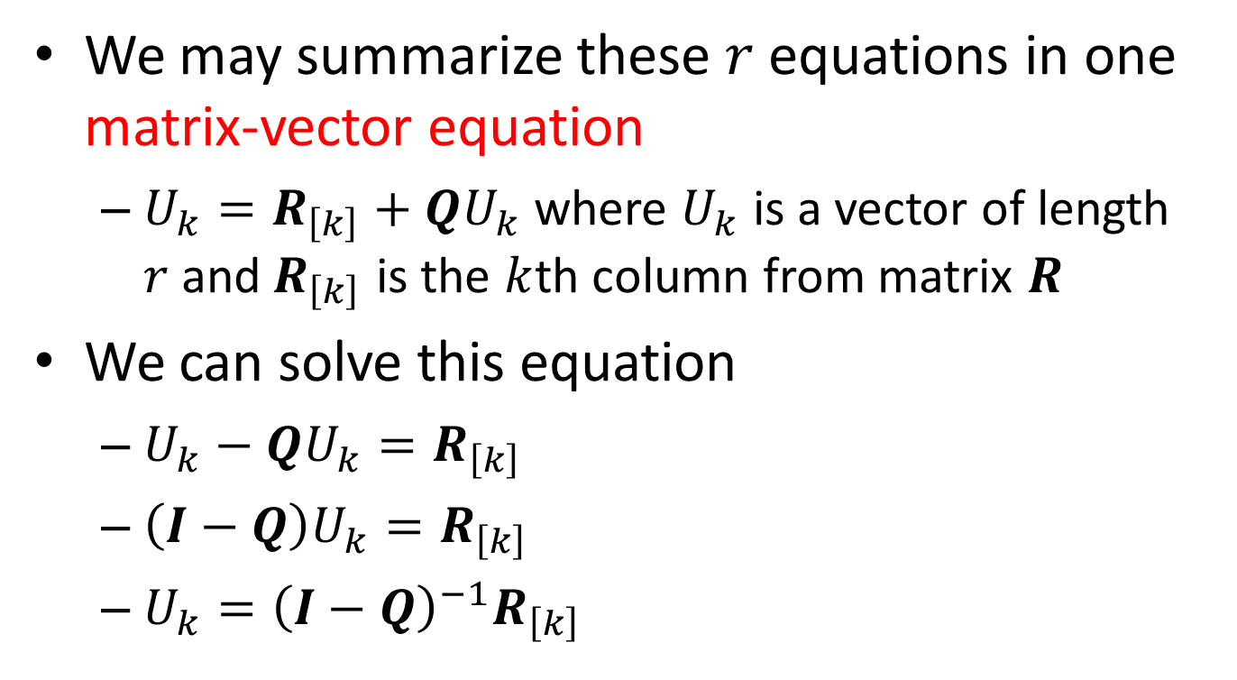
General First Step Analysis
We may summarize these $r$ equations in one matrix-vector equation
$U_{k}=R_{\left[k\right]}+QU_{k}$ where $U_{k}$ is a vector of length $r$and$R_{\left[k\right]}$ is the $k$th column from matrix $R$
We can solve this equation
$U_{k}−QU_{k}=R_{\left[k\right]}$
$\left(I−Q\right)U_{k}=R_{\left[k\right]}$
$U_{k}={\left(I−Q\right)}^{−1}R_{\left[k\right]}$

Slide 18
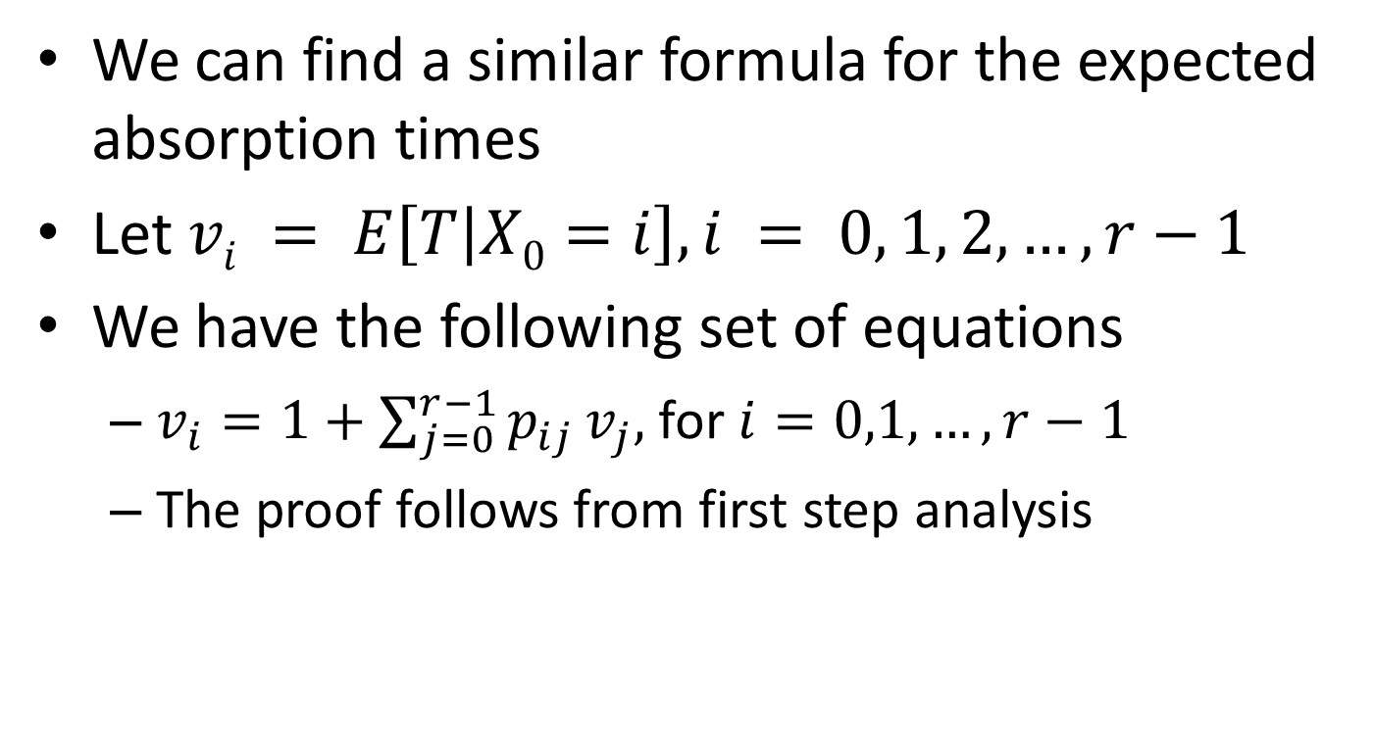
General First Step Analysis
We can find a similar formula for the expected absorption times
Let $vi = E\left[T | X0=i\right], i = 0, 1, 2,…, r−1$
We have the following set of equations
$v_{i}=1+\sum_{j=0}^{r−1}{p_{ij}}v_{j},$ for $i=0,1,…,r−1$
The proof follows from first step analysis

Slide 19
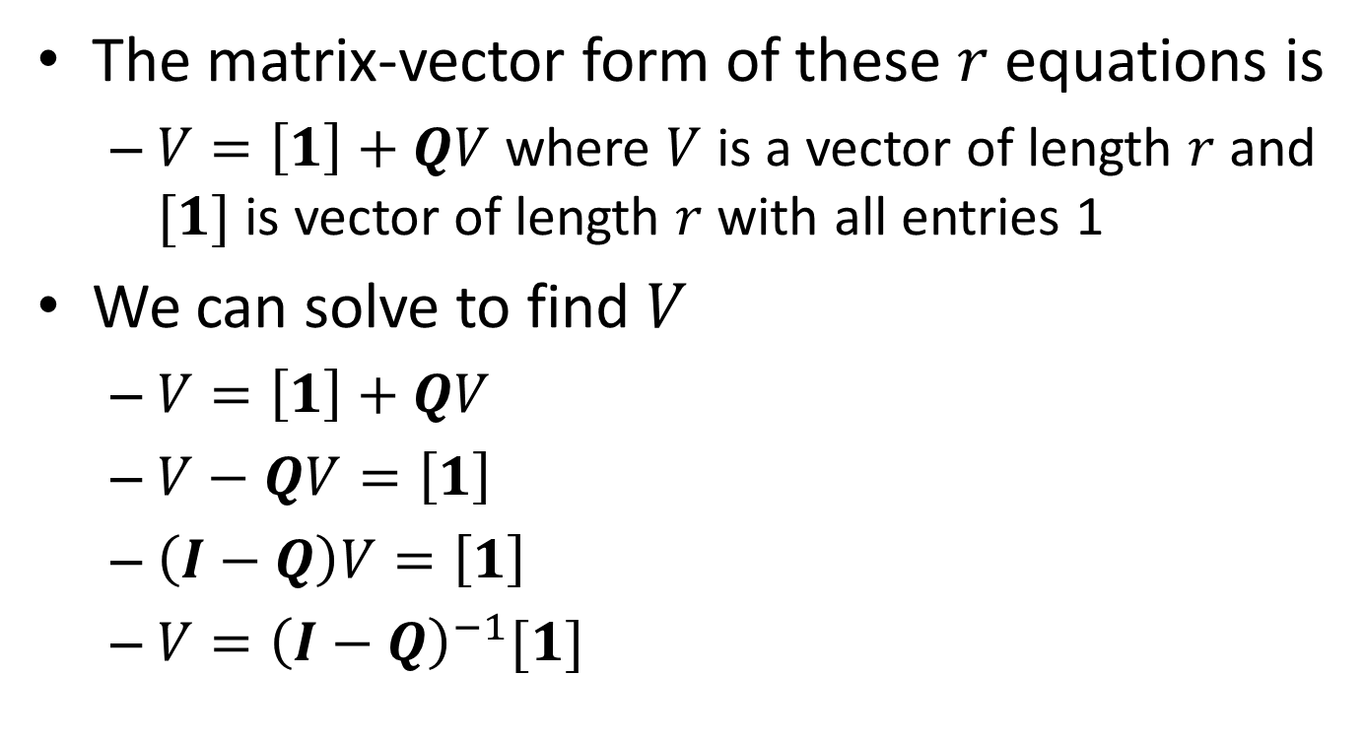
General First Step Analysis
The matrix-vector form of these $r$ equations is
$V=\left[1\right]+QV$ where $V$ is a vector of length $r$and $[1]$ is vector of length $r$ with all entries 1
We can solve to find $V$
$V=\left[1\right]+QV$
$V−QV=\left[1\right]$
$\left(I−Q\right)V=\left[1\right]$
$V={\left(I−Q\right)}^{−1}[1]$

Slide 20
Example – A Rat In A Maze
0 | 1 | 7 FOOD
2 | 3 | 4
8 SHOCK | 5 | 6

Slide 21

Example – A Rat In A Maze
$P= \left(\begin{matrix} & \frac{1}{2} & \frac{1}{2} & & & & & & \\ \frac{1}{3} & & & \frac{1}{3} & & & & \frac{1}{3} & \\ \frac{1}{3} & & & \frac{1}{3} & & & & & \frac{1}{3} \\ & \frac{1}{4} & \frac{1}{4} & & \frac{1}{4} & \frac{1}{4} & & & \\ & & & \frac{1}{3} & & & \frac{1}{3} & \frac{1}{3} & \\ & & & \frac{1}{3} & & & \frac{1}{3} & & \frac{1}{3} \\ & & & & \frac{1}{2} & \frac{1}{2} & & & \\ & & & & & & 1 & 1 & \\ & & & & & & & & 1\end{matrix}\right)$

Slide 22
Example – A Rat In A Maze
Consider the probability of the chain being absorbed in state 7. We have the equations

Slide 23
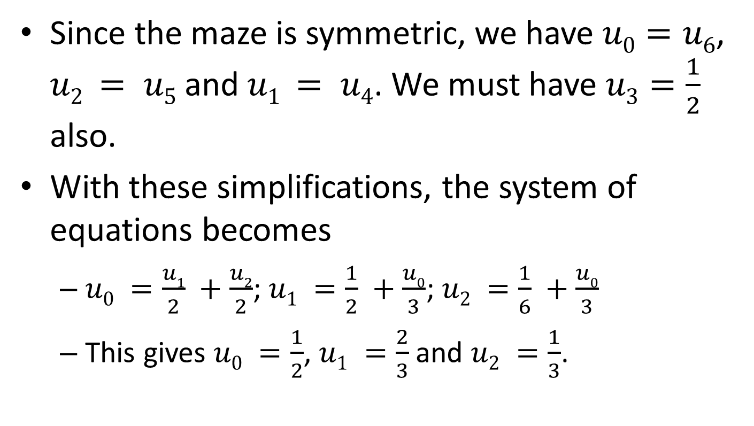
Example – A Rat In A Maze
Since the maze is symmetric, we have $u0=u6$, $u2 = u5$and $u1 = u4$. We must have $u3=\frac{1}{2}$ also.
With these simplifications, the system of equations becomes
$u0 =\frac{u1}{2} +\frac{u2}{2}$;$u1 =\frac{1}{2} +\frac{u0}{3}$;$u2 =\frac{1}{6} +\frac{u0}{3}$
This gives $u0 =\frac{1}{2}$, $u1 =\frac{2}{3}$and $u2 =\frac{1}{3}$.

Slide 24
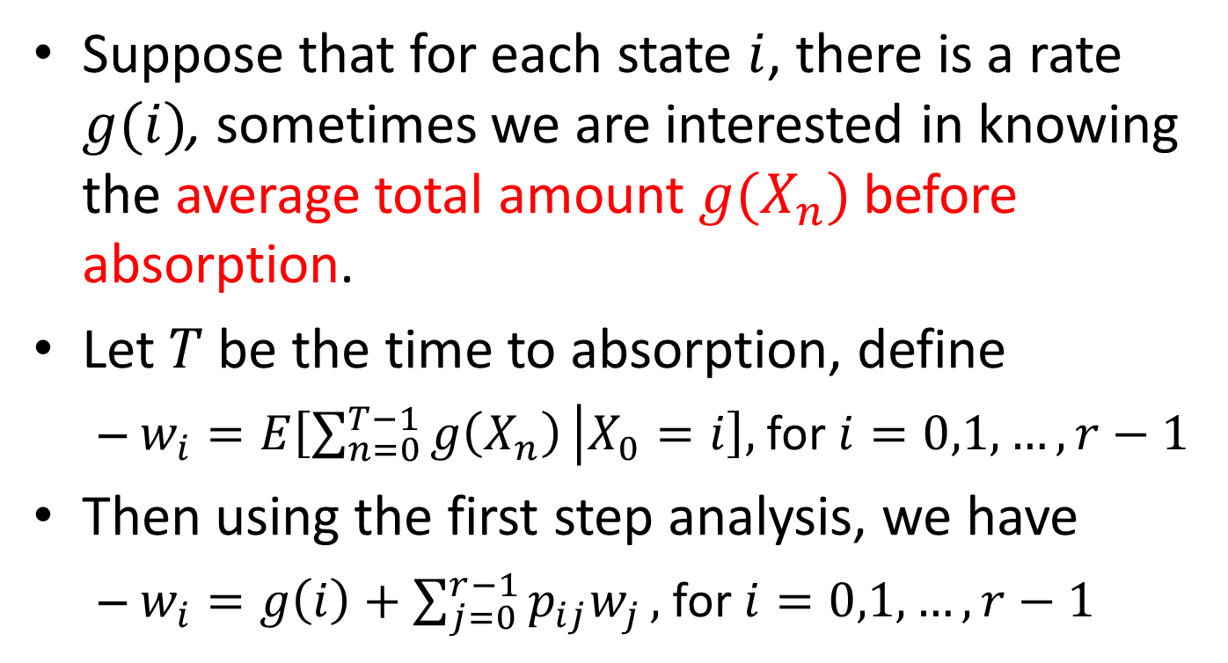
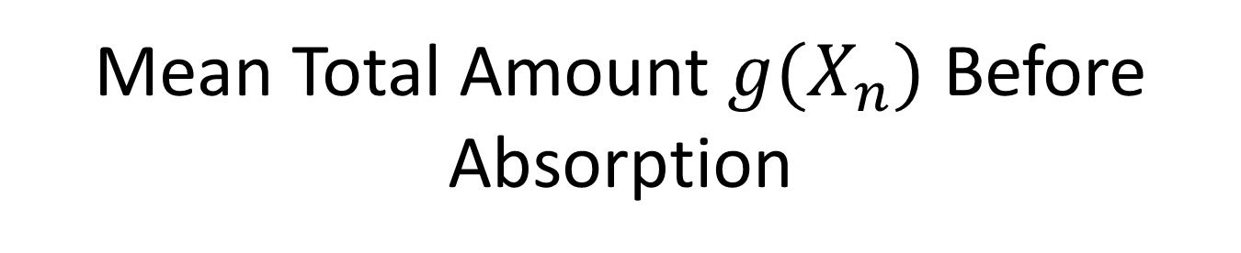
Mean Total Amount $g(X_{n})$ Before Absorption
Suppose that for each state $i$, there is a rate $g(i)$, sometimes we are interested in knowing the average total amount $g(X_{n})$ before absorption.
Let $T$ be the time to absorption, define
$w_{i}=E\left[\sum_{n=0}^{T−1}{g\left(X_{n}\right)} | X_{0}=i\right],$for $i=0,1,…,r−1$
Then using the first step analysis, we have
$w_{i}=g\left(i\right)+\sum_{j=0}^{r−1}{p_{ij}w_{j}},$ for $i=0,1,…,r−1$

Slide 25
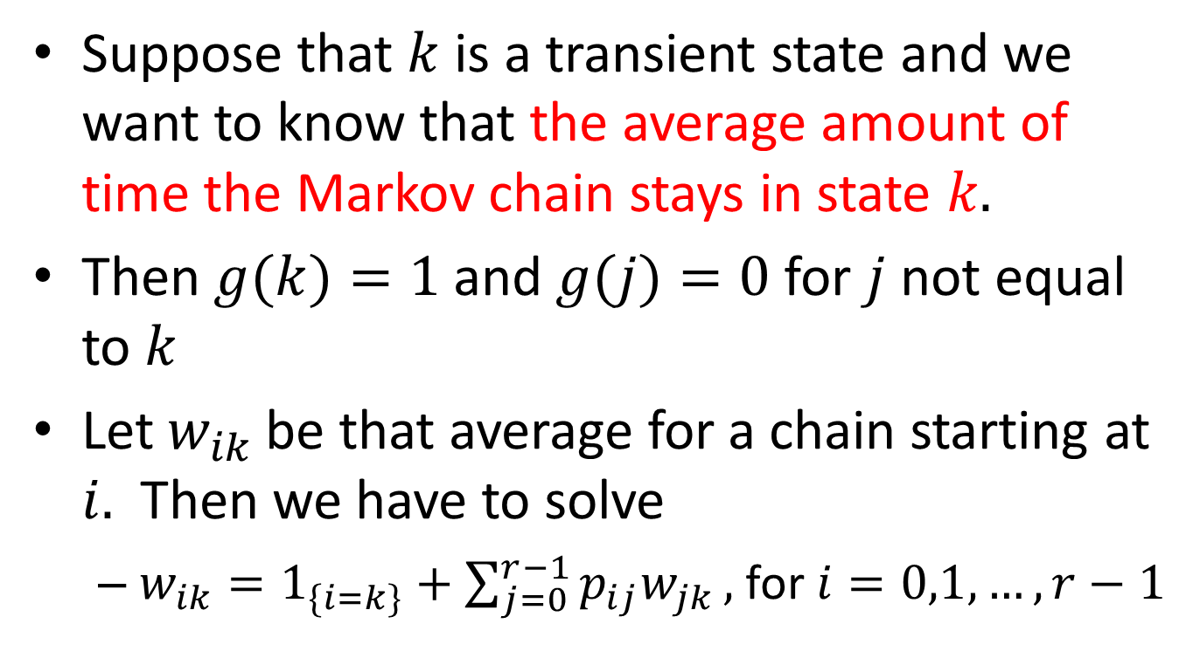
Mean Total Amount $g(X_{n})$ Before Absorption
Suppose that $k$ is a transient state and we want to know that the average amount of time the Markov chain stays in state $k.$
Then $g(k)=1$and $g(j)=0$for $j$ not equal to $k$
Let $w_{ik}$be that average for a chain starting at $i.$ Then we have to solve
$w_{ik}=1_{\{i=k\}}+\sum_{j=0}^{r−1}{p_{ij}w_{jk}},$ for $i=0,1,…,r−1$

Slide 26
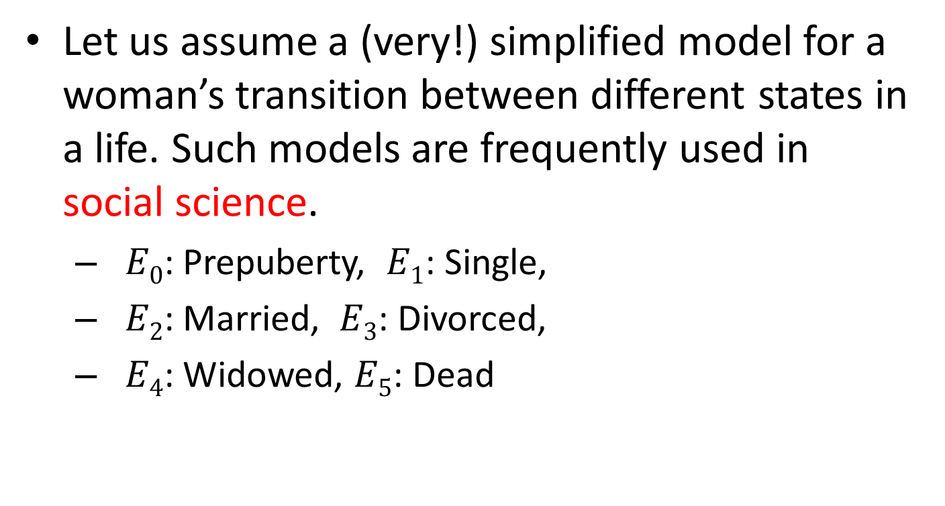
Example: An (old) Model of Fecundity
Let us assume a (very!) simplified model for a woman’s transition between different states in a life. Such models are frequently used in social science.
$E0$: Prepuberty, $E1$: Single,
$E2$: Married, $E3$: Divorced,
$E4$: Widowed, $E5$: Dead

Slide 27
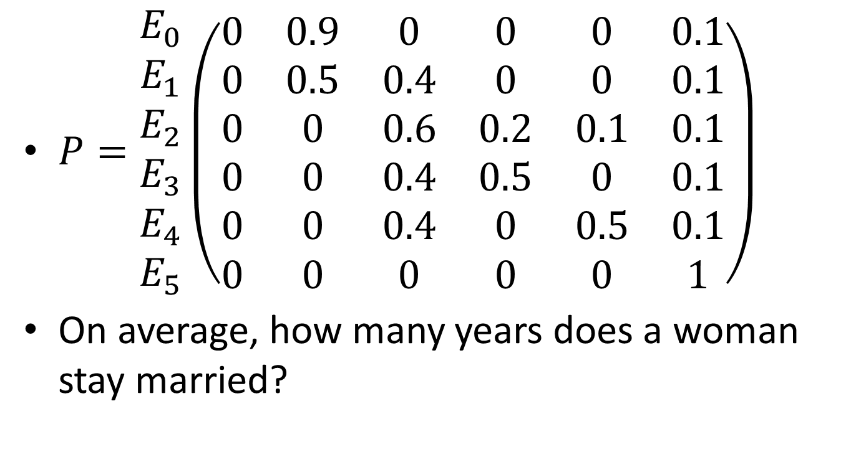
Example: An (old) Model of Fecundity
$P=\begin{matrix}E_{0} \\ E_{1} \\ E_{2} \\ E_{3} \\ E_{4} \\ E_{5}\end{matrix}\left(\begin{matrix}0 & 0.9 & 0 & 0 & 0 & 0.1 \\ 0 & 0.5 & 0.4 & 0 & 0 & 0.1 \\ 0 & 0 & 0.6 & 0.2 & 0.1 & 0.1 \\ 0 & 0 & 0.4 & 0.5 & 0 & 0.1 \\ 0 & 0 & 0.4 & 0 & 0.5 & 0.1 \\ 0 & 0 & 0 & 0 & 0 & 1\end{matrix}\right)$
On average, how many years does a woman stay married?

Slide 28
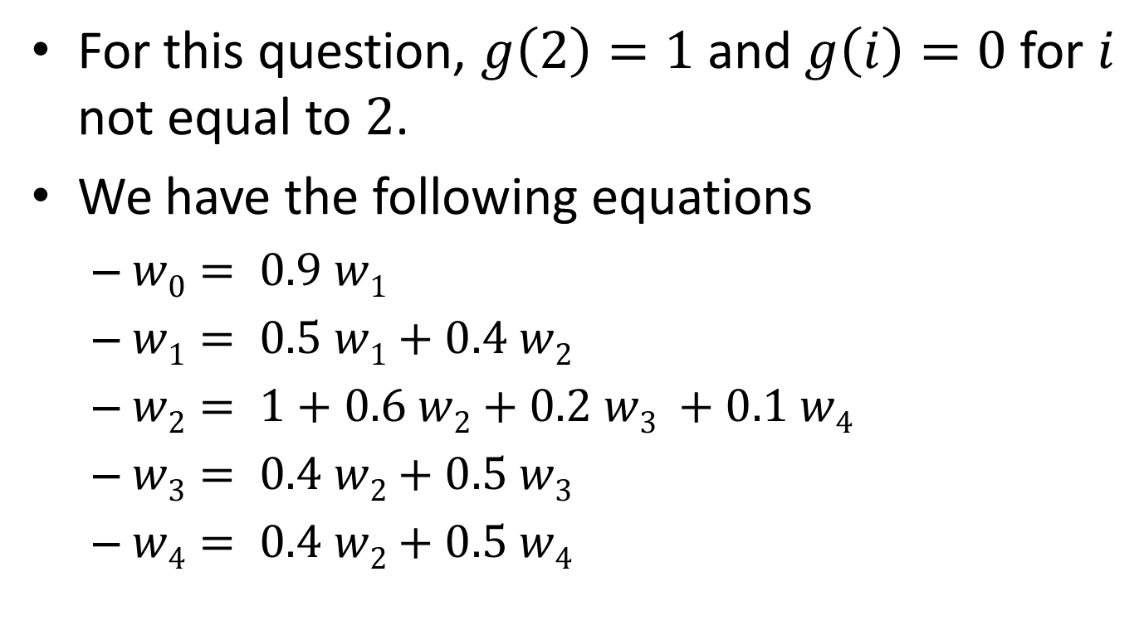
Example: An (old) Model of Fecundity
For this question, $g\left(2\right)=1$ and $g\left(i\right)=0$ for $i$ not equal to $2$.
We have the following equations
$w0= 0.9 w1$
$w1= 0.5 w1+0.4 w2$
$w2= 1+0.6 w2+0.2 w3 +0.1 w4$
$w3= 0.4 w2+0.5 w3$
$w4= 0.4 w2+0.5 w4$

Slide 29
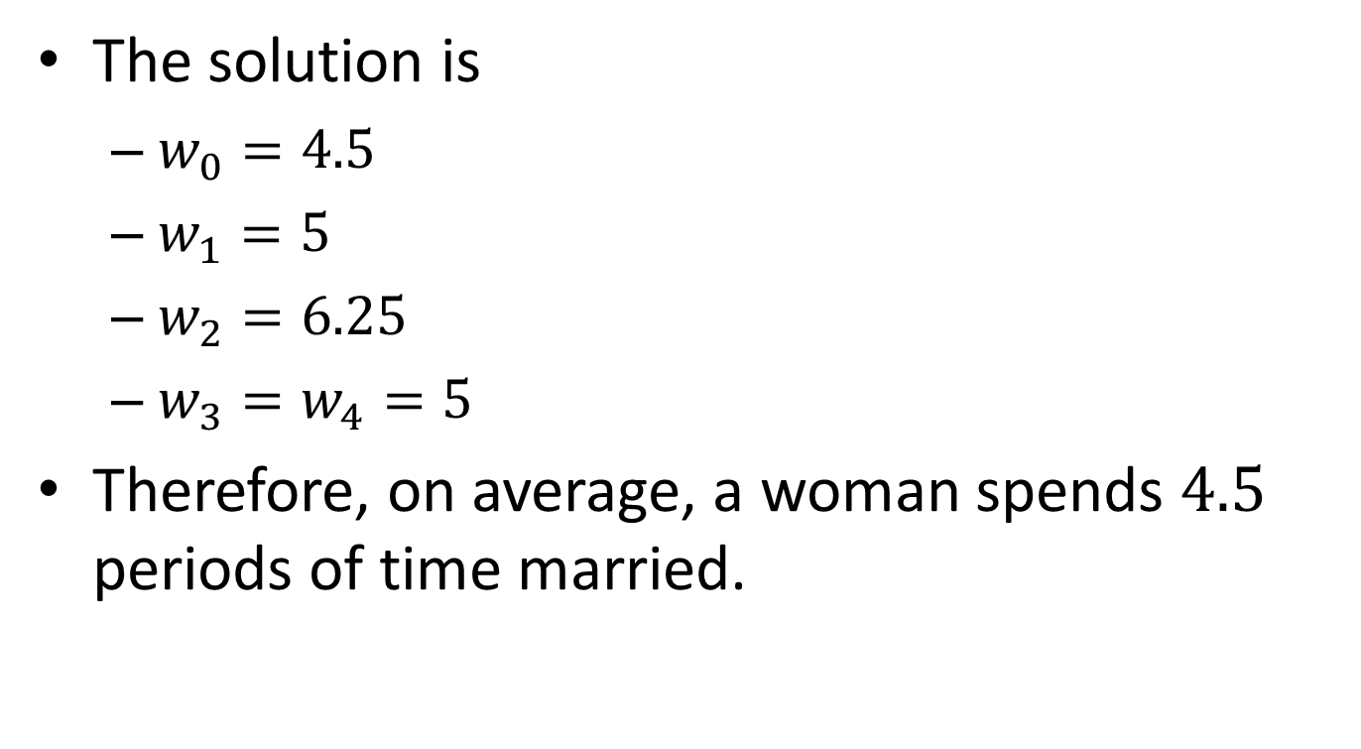
Example: An (old) Model of Fecundity
The solution is
$w_{0}=4.5$
$w_{1}=5$
$w_{2}=6.25$
$w_{3}=w_{4}=5$
Therefore, on average, a woman spends $4.5$ periods of time married.

